Slide 1
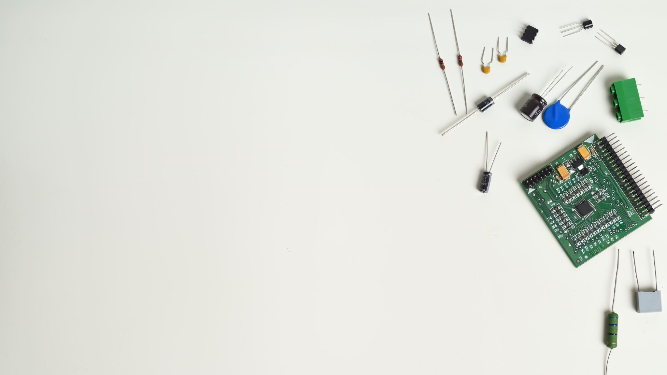
IOT BASED SMART GARAGE DOOR OPENER
GROUP-4

Slide 2
INTERFACING GSM MODULE WITH ARDUINO UNO
PRESENTED BY- GOPIKRISHNAN KG

Slide 3
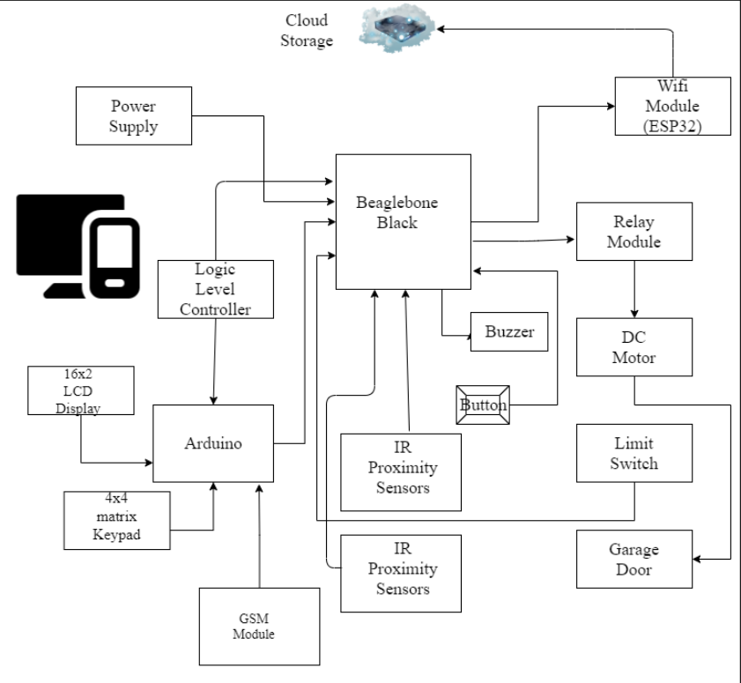
Block Diagram

Slide 4
Why to Interface GSM Module with Arduino?
Arduino is an essential component which enhances the security feature in the project
Arduino is connected to Keypad matrix, LCD screen, Logic Level controller and GSM module.
GSM module notifies the user about any security breach.
It sends notifications to user when garage door is opened, closed and a wrong password is entered three times.
Essential component with regards to safety

Slide 5

HARDWARE COMPONENTS USED
Arduino Uno
LCD Screen
4*4 Keypad
GSM Module
Jumper wires
Breadboard
Host Machine and USB cable

Slide 6
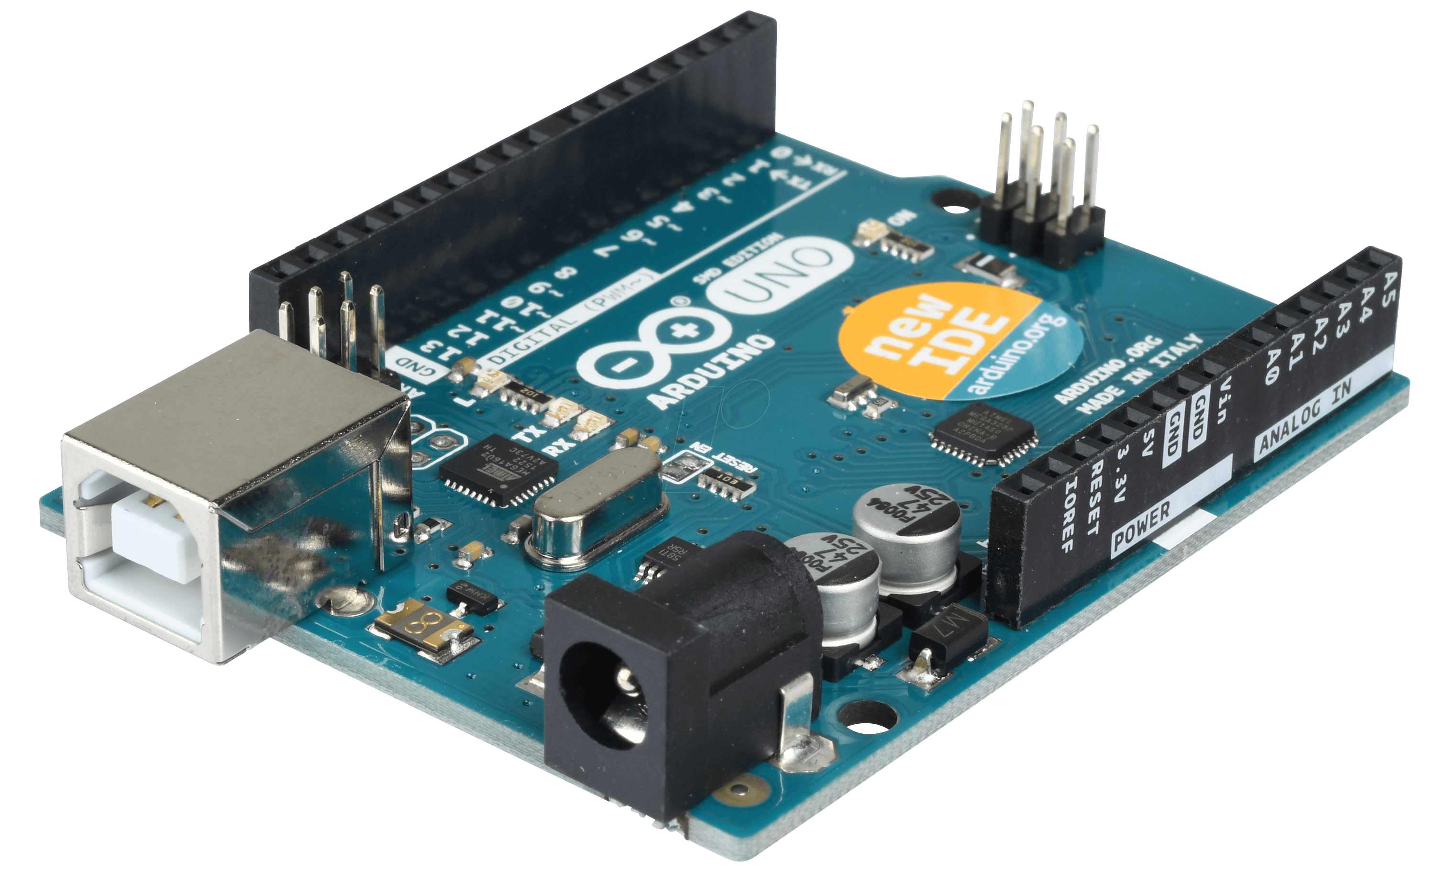
ARDUINO UNO

Slide 7
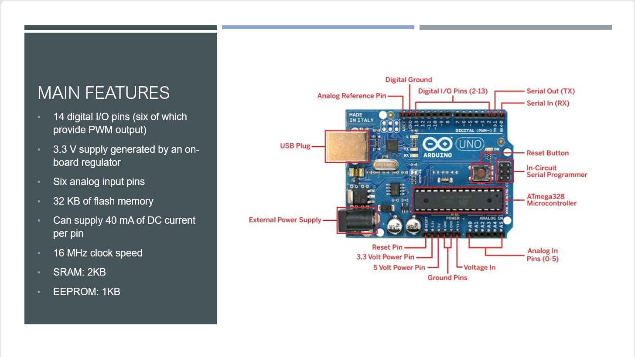

Slide 8
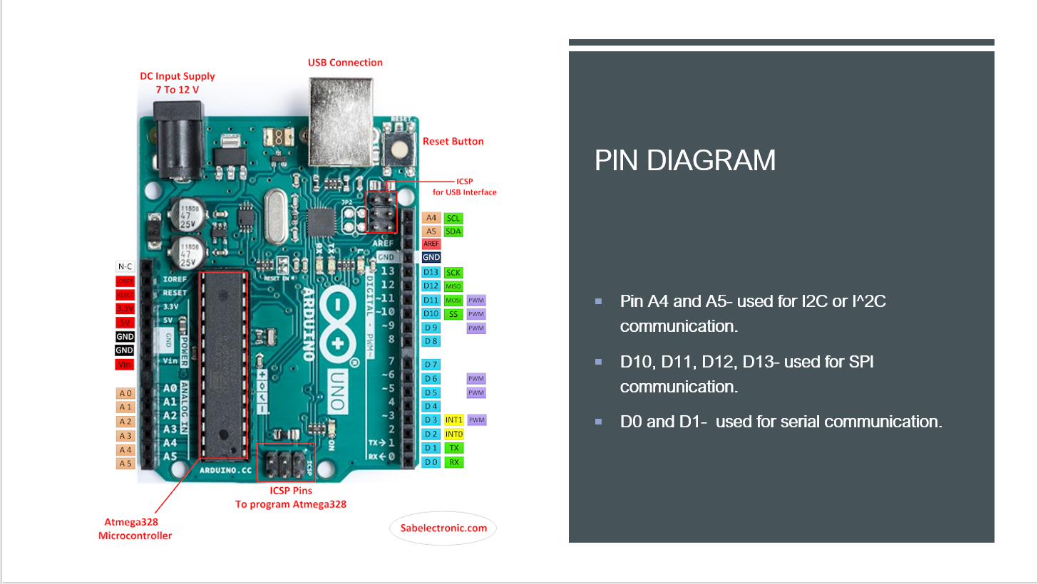

Slide 9
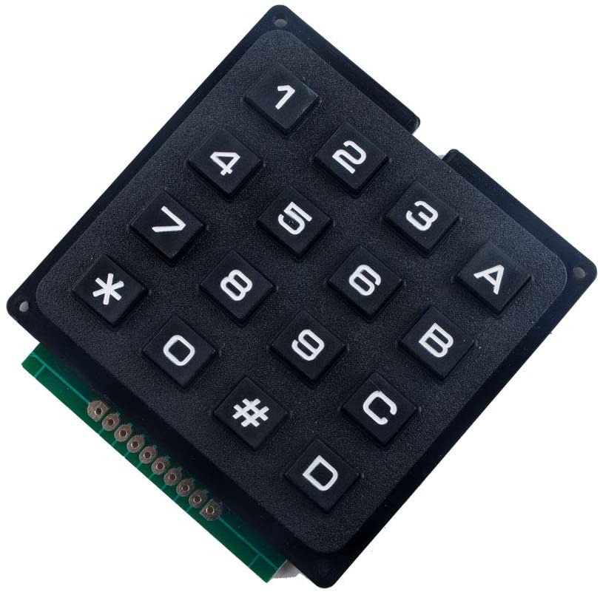
4*4 KEYPAD MATRIX
Can play a role while opening and closing the garage door
Used as an alternative for garage door access in case of internet failure.
Used for entering the password for garage door opening.
Works alongside with LCD display
Once opened, closing of the garage door will be enabled by pressing a keypad key.

Slide 10
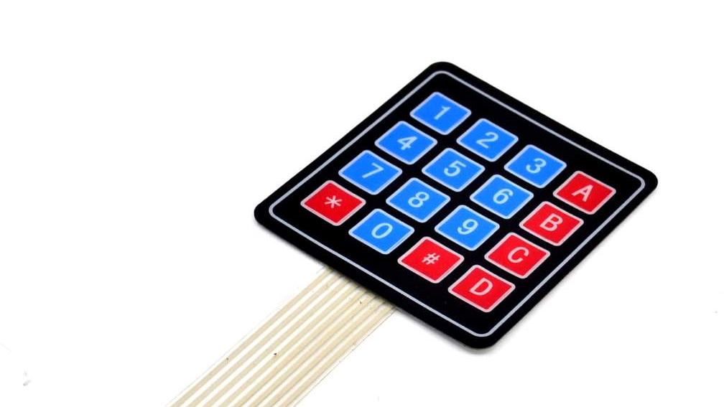
SPECIFICATIONS
4*4 design
Voltage rating- 35V DC max
Current rating- 100 mA
4 Numeric keys, 4 English Keys, 2 Function keys
16 inputs
Used popularly for password security system

Slide 11
Pin Connections
C1 to C4 -> A0 to A4 of Arduino
R1 -> Pin 8 of Arduino
R2 -> Pin 9 of Arduino
R3 -> Pin 12 of Arduino
R4 -> Pin 13 of Arduino

Slide 12
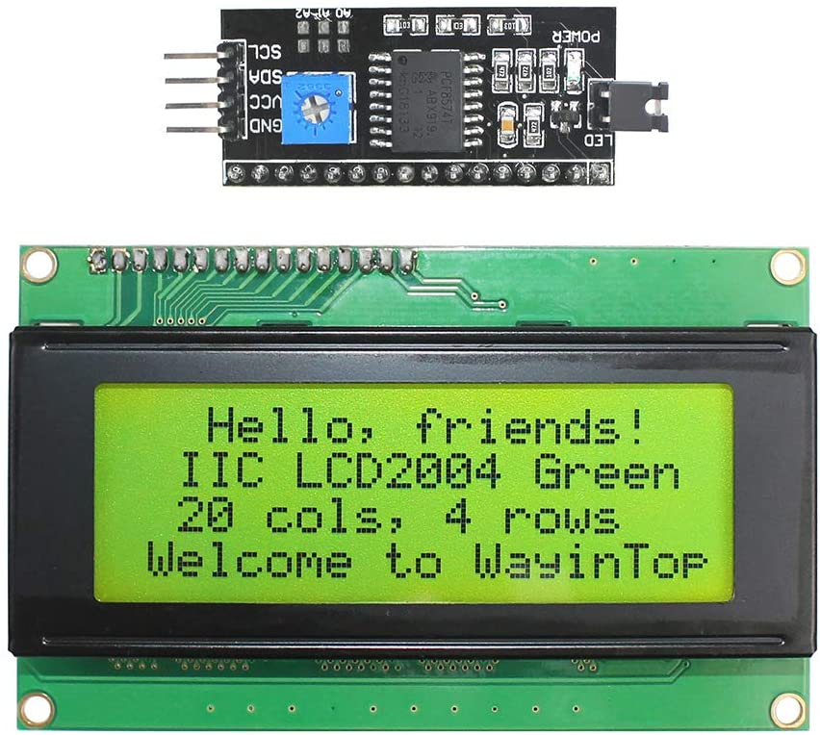
LCD SCREEN
Can display 20 characters in a row, in total 80 characters
Can play a role while opening the garage door
Displays the user inputs as a special character
Displays messages to the user

Slide 13
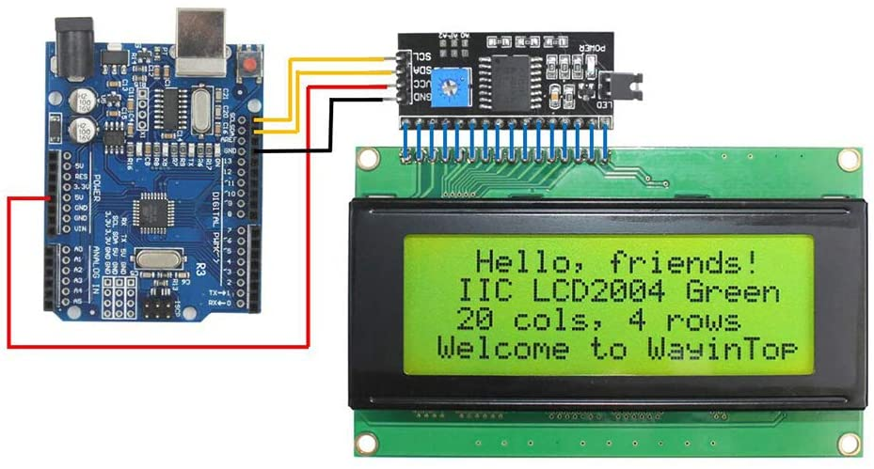
SPECIFICATIONS
20*4: 20 Columns, 4 Rows
Contains IIC/I2C/TWI serial interface Adapter
Less I/O ports are occupied, only four –Vcc, GND,SDA(Serial Data Line), SCL(Serial Clock Line)
Working voltage: 5V

Slide 14
Pin Connections
Vcc -> Vin of Arduino
Gnd -> Gnd of Arduino
Scl -> A5 pin of Arduino
Sda -> A4 pin of Arduino

Slide 15
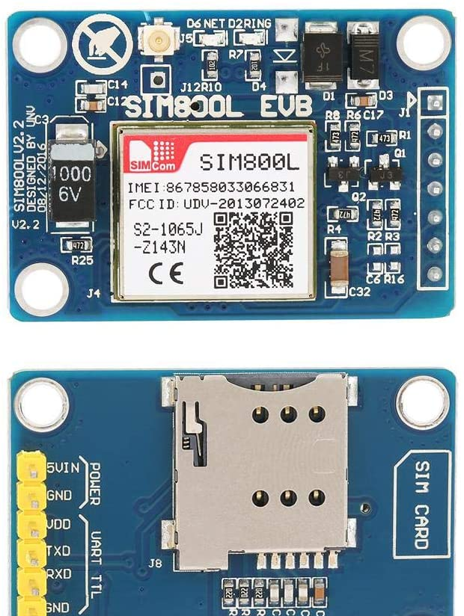
SIM800L GSM Module
Plays a part while opening and closing the garage door
An important security feature
Notifies the user via SMS while the garage door is opened or closed or if a wrong password is entered 3 times
Thus, user can be sure about the security and status of garage door

Slide 16
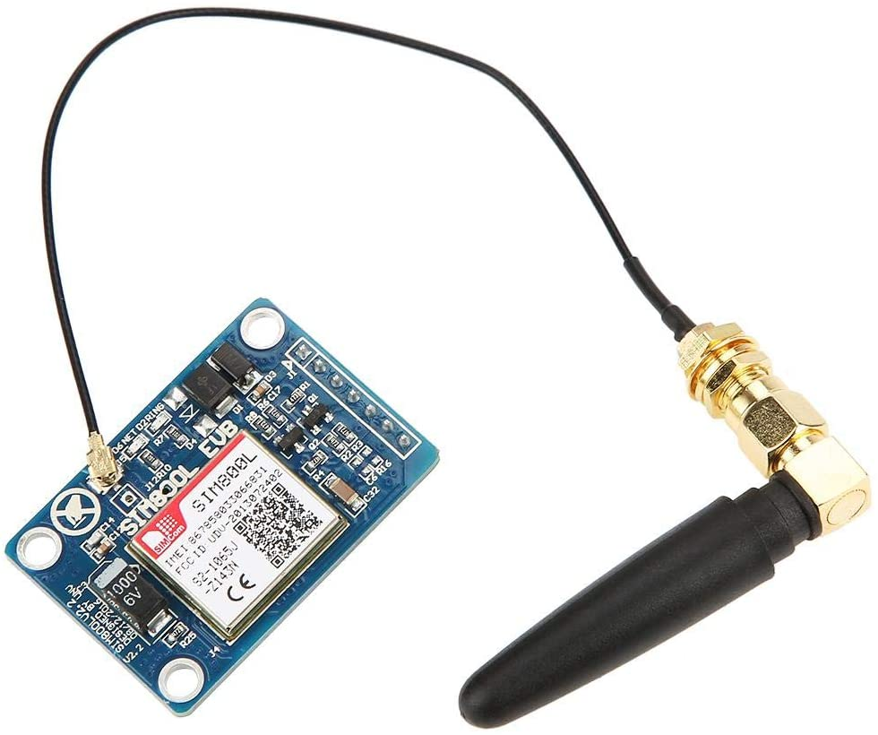
SPECIFICATIONS
Based on GPRS standard
Operating voltage: 5V
Compact and stable: Suitable for embedded system design
Self projectile card slot
Can conveniently change mobile-phone card
Use IPX interface
Can arbitrarily change the antenna

Slide 17
Pin Connections
Vin –> 5V of Arduino
Gnd -> Gnd of Arduino
Tx -> Pin 10 of Arduino
Rx -> Pin 11 of Arduino

Slide 18
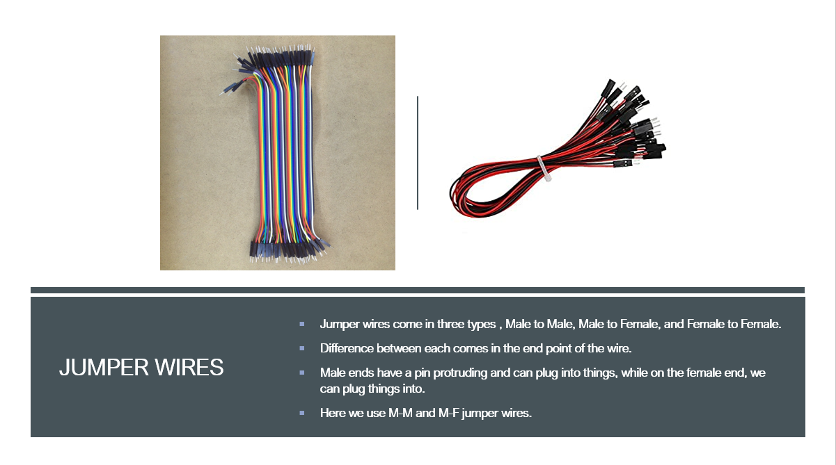

Slide 19
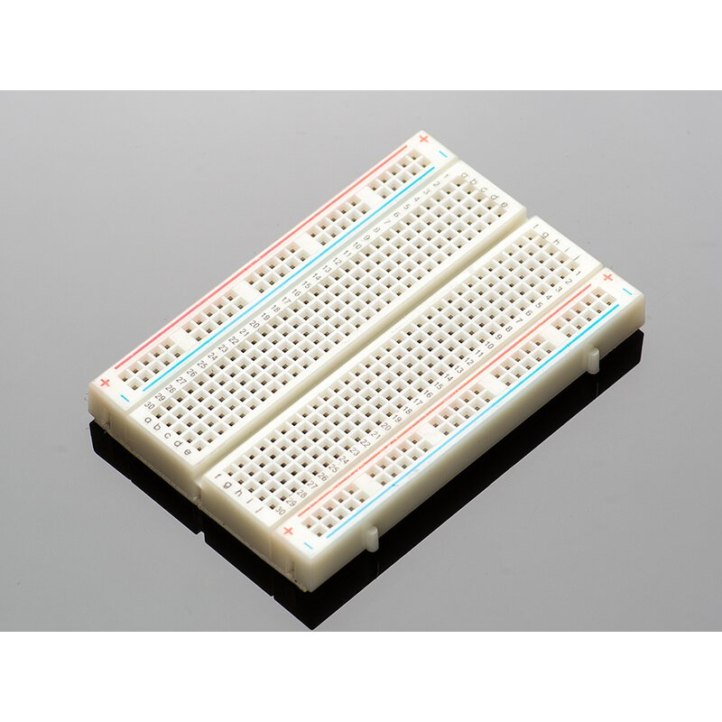
Breadboard
It is a construction base for prototyping of electronics
In this interfacing it was used for establishing various connections and for multiple accessing of various pins like 5V power supply

Slide 20


Slide 21
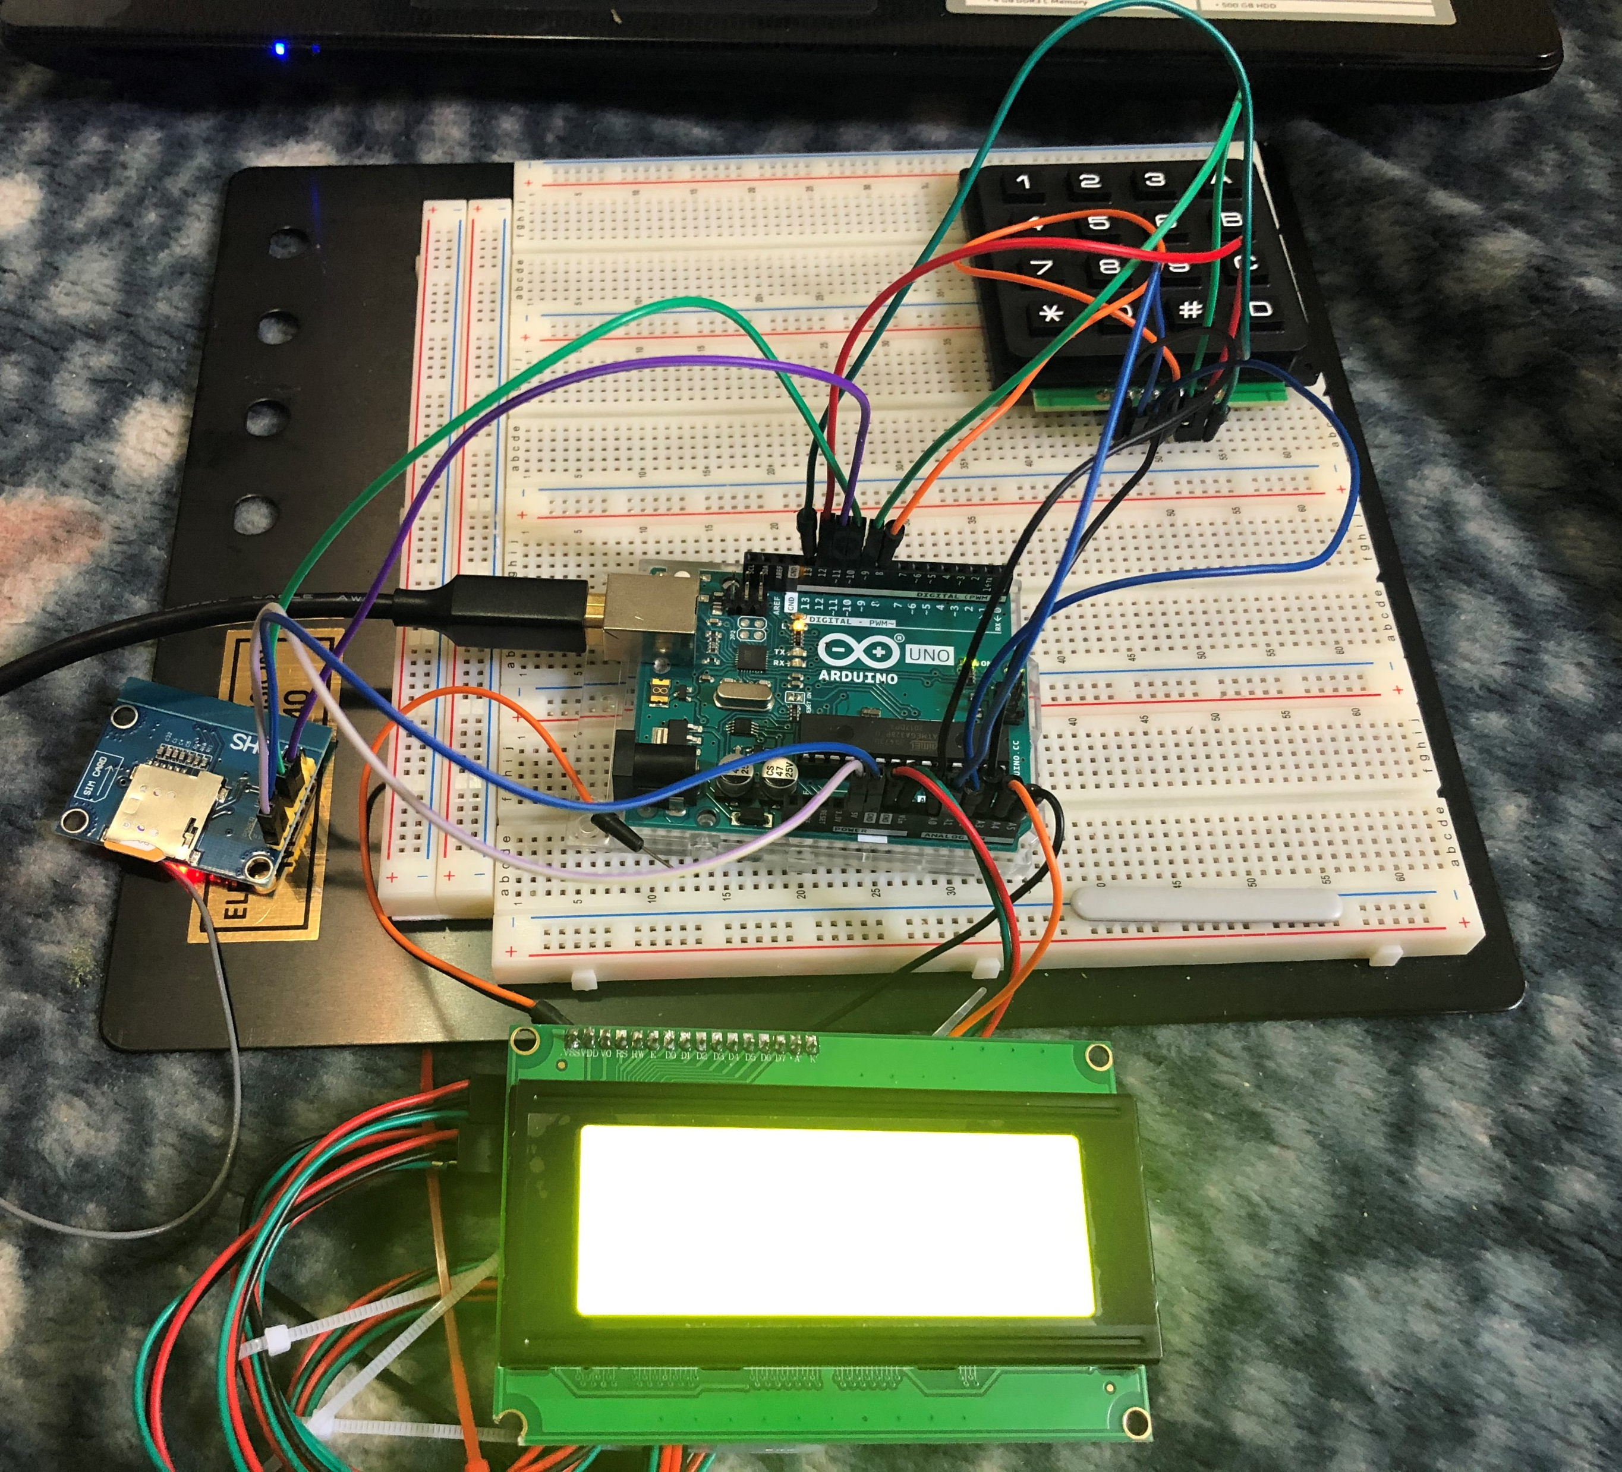
Circuit

Slide 22

Software Part of the interfacing

Slide 23
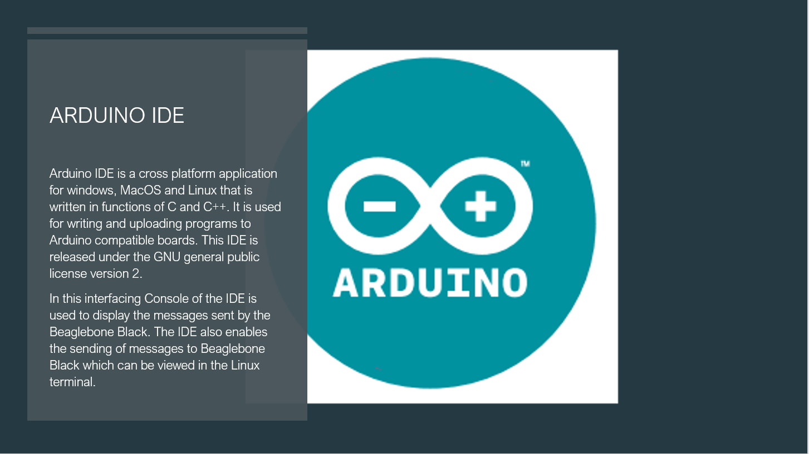

Slide 24
LIBRARIES USED
wire.h -> This library allows to communicate between I2C/TWI devices. On the Arduino Uno board it is enabled by SDA(A4) and SCL(A5) pins.
LiquidCrystal.h -> Allows communication with Alphanumeric Liquid Crystal Displays
Keypad.h -> It is used for using Matrix style keypads with Arduino
SoftwareSerial.h -> Multi Instance software serial library for Arduino/Wiring

Slide 25

C Code

Slide 26
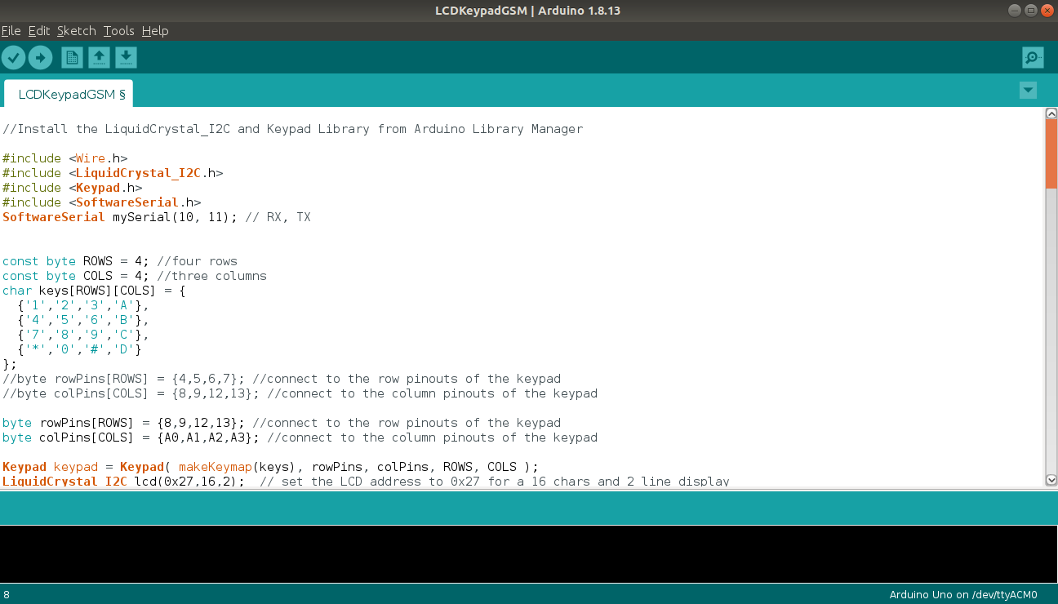

Slide 27
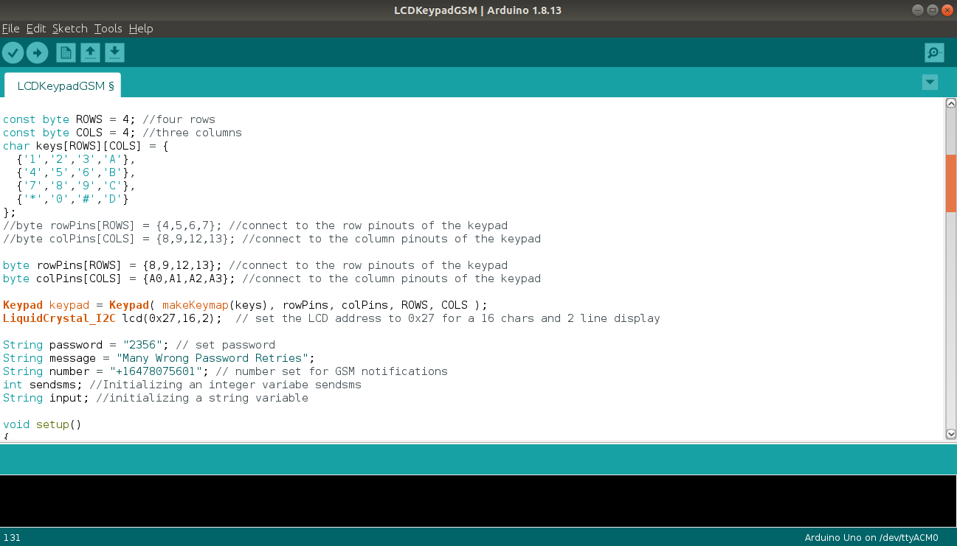

Slide 28
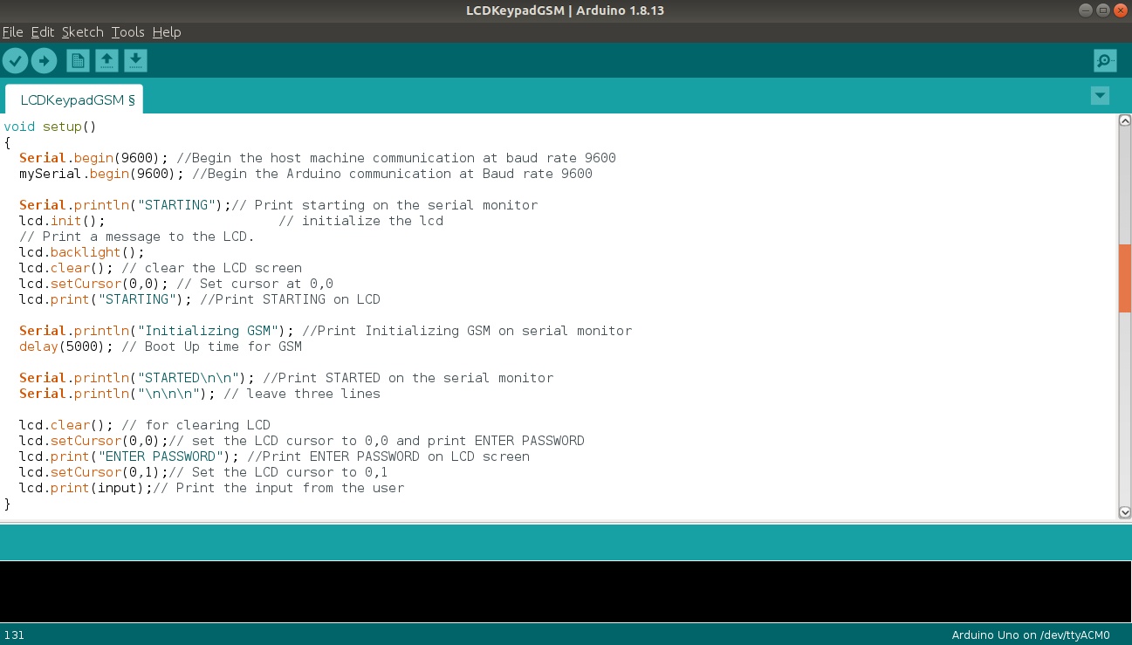

Slide 29
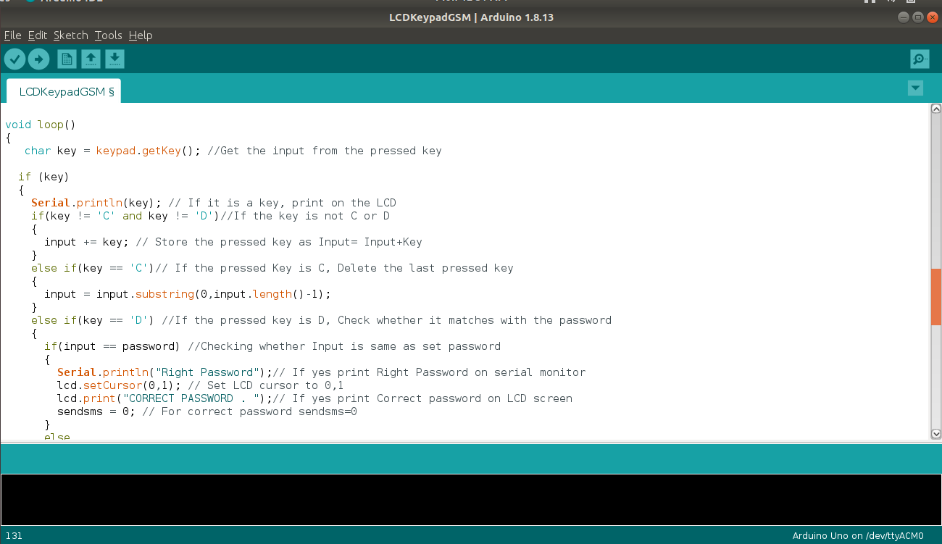

Slide 30
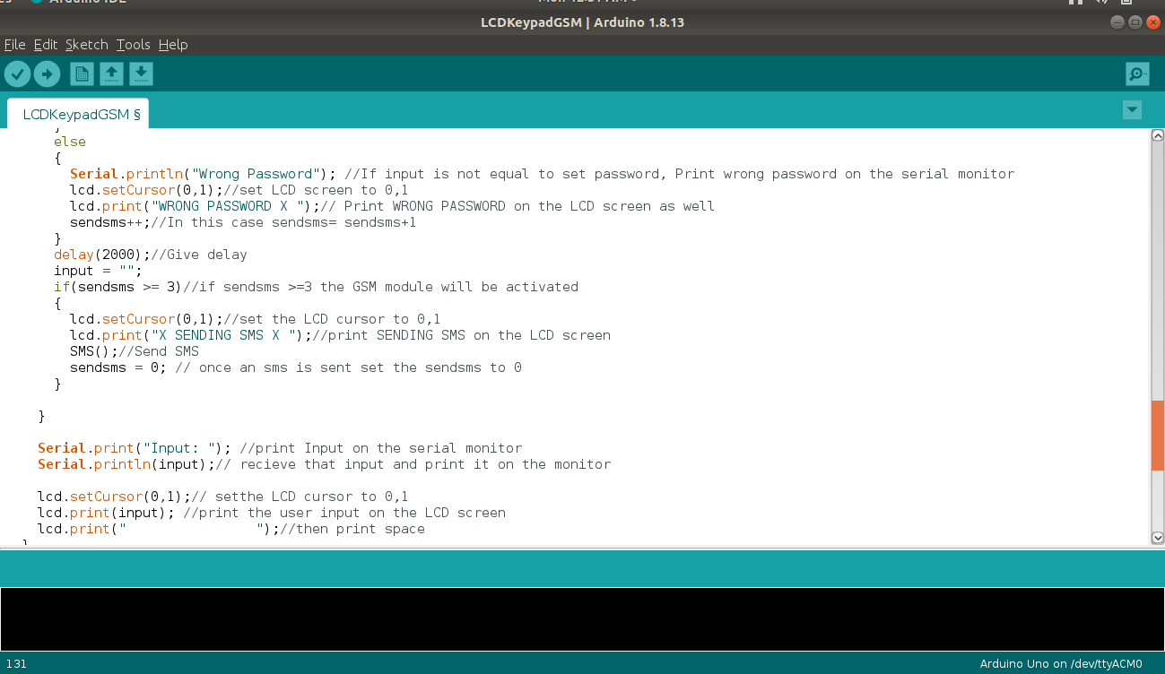

Slide 31
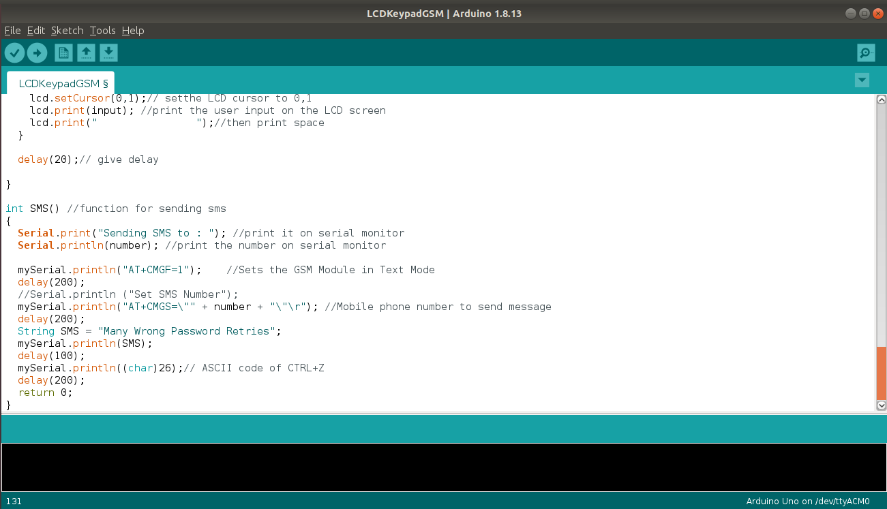

Slide 32
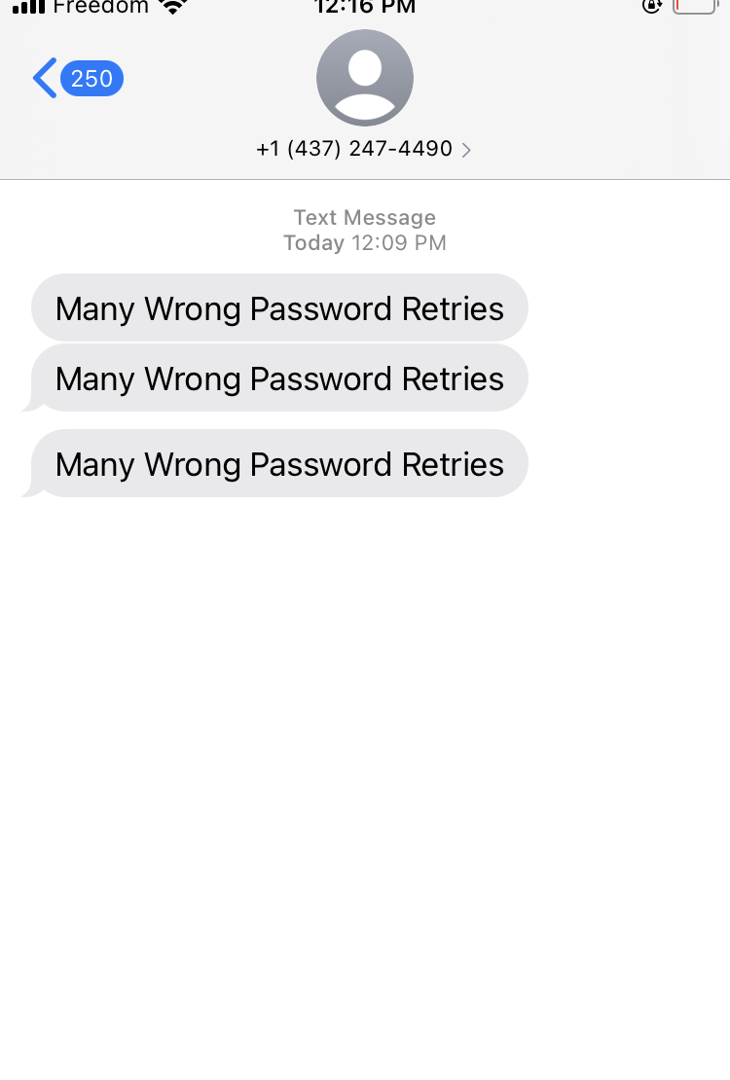
Message received from GSM Module

Slide 33
References
Retrieved from lastminuteengineers.com, Send Receive SMS & Call with SIM800L GSM Module & Arduino. URL:https://lastminuteengineers.com/sim800l-gsm-module-arduino-tutorial/
Retrieved from factforward.com, SIM 800L GSM module with Arduino AT Commands Library. URL:https://www.factoryforward.com/sim800l-gsm-module-arduino-commands-library/
Retrieved from Amazon.ca, DIY malls 4*4 Matrix Membrane Keypad 16 keys Keyboard Module Array Switch for Arduino Uno R3 URL: https://www.amazon.ca/dp/B086ZGKDK9/ref=cm_sw_r_wa_apa_i_79TG40BP7MPFDC5C7MCA?_encoding=UTF8&psc=1
Retrieved from Components101.com, Arduino UNO( 2018, February 18) URL:https://components101.com/microcontrollers/arduino-uno

Slide 34
References
Retrieved from mechatrofice.com, Keypad Interfacing with Arduino 4*4,4*3 connection and Code URL:https://mechatrofice.com/arduino/keypad-interfacing-with-arduino
Retrieved from circuitstoday.com , Interfacing LCD to Arduino- Display Text and Characters on LCD Screen using Arduino URL:https://www.circuitstoday.com/interfacing-lcd-to-arduino
Retrieved from lastminuteengineers.com, Send Receive SMS & Call with SIM900 GSM Shield & Arduino URL: https://lastminuteengineers.com/sim900-gsm-shield-arduino-tutorial/
Retrieved from indestructables.com , Arduino 16*2 LCD Display and 4*4 Matrix Keypad URL:https://www.instructables.com/Arduino-16x2-LCD-Display-and-4x4-Matrix-Keypad/

Slide 35
References
Retrieved from electroniclinic.com, URL:
https://www.electroniclinic.com/password-door-lock-security-system-using-arduino-and- keypad/
Retrieved from Youtube.com, URL:
https://www.youtube.com/watch?v=wfdcJASjqB0

Slide 36

Thank You

